Slide 1
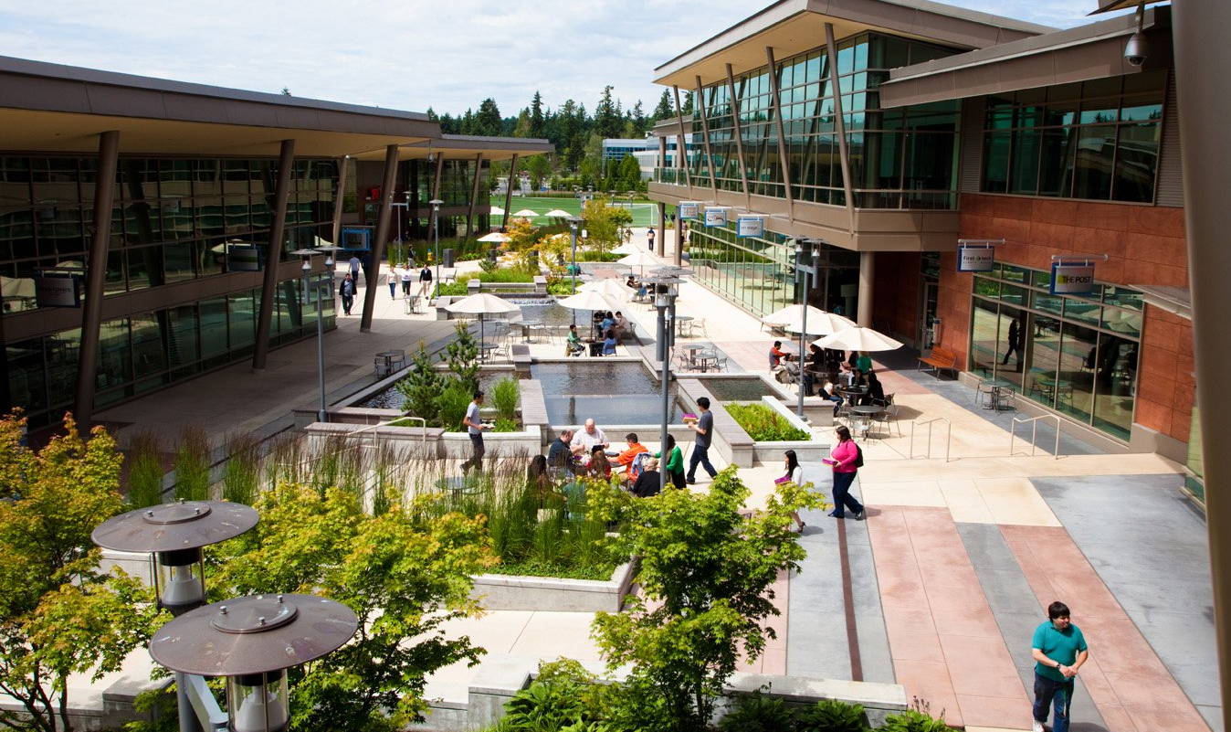
컴퓨팅사고와 SW코딩
안병준 coolbrise@knu.ac.kr

Slide 2
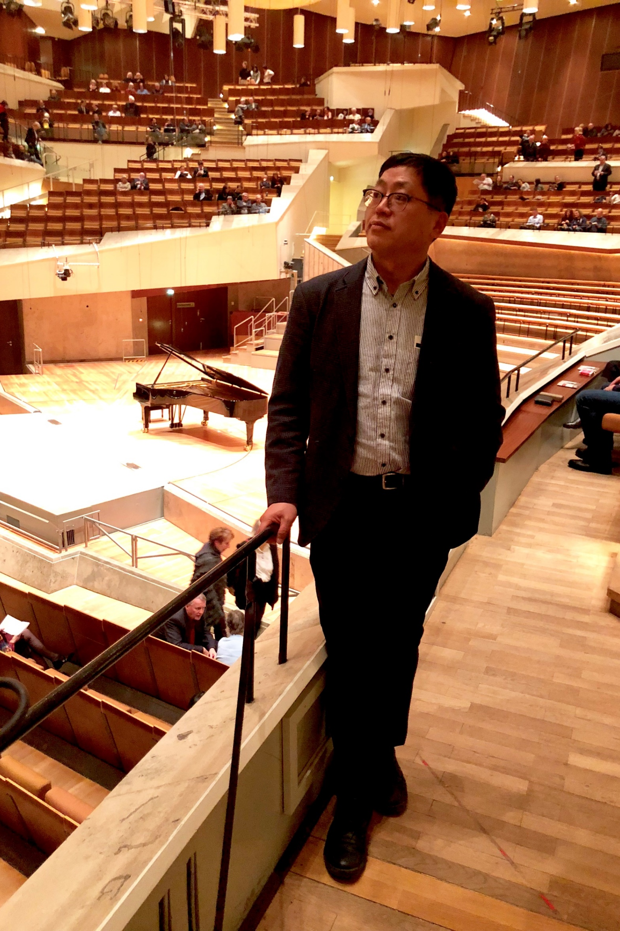
안 병 준
경북대학교 컴퓨터학부 겸임교수
coolbrise@knu.ac.kr
경북대학교 컴퓨터학부 동문회 부회장 / 사무국장
High Performance Computing Specialist
Microsoft Korea
Samsung SDS
Distinguished Toastmaster
Johann Sebastian Bach

Slide 3


Slide 4
Ice Breaking
Form a group of two people
One person talks to the other for 3 minutes.
The other listens to him or her without saying anything.
Change the roles after 3 minutes.
Theme : What did you do during the winter vacation?
Presenter : Share what you did during the winter vacation.

Slide 5


Slide 6


Slide 7
Supplementary textbooks
Python Documentation
어서와 파이썬은 처음이지
파워 유저를 위한 파이썬 Express
(609) 널널한 교수의 으뜸 파이썬 - YouTube
점프 투 파이썬
코드 CODE

Slide 8
Teaching
Ground rules
Submit your assignments by the deadline
Zero Tolerance - equal or more than 4 absences
Tutors
이지성
조해민

Slide 9
Final Grade
Mid-term exam : 30%
Final exam : 30%
Assignments : 20%
Submit your assignments via email by 23:59:59 next Thursday
Attendance : 10%
Four absences will make both you and me unhappy.
Attitude : 10%

Slide 10
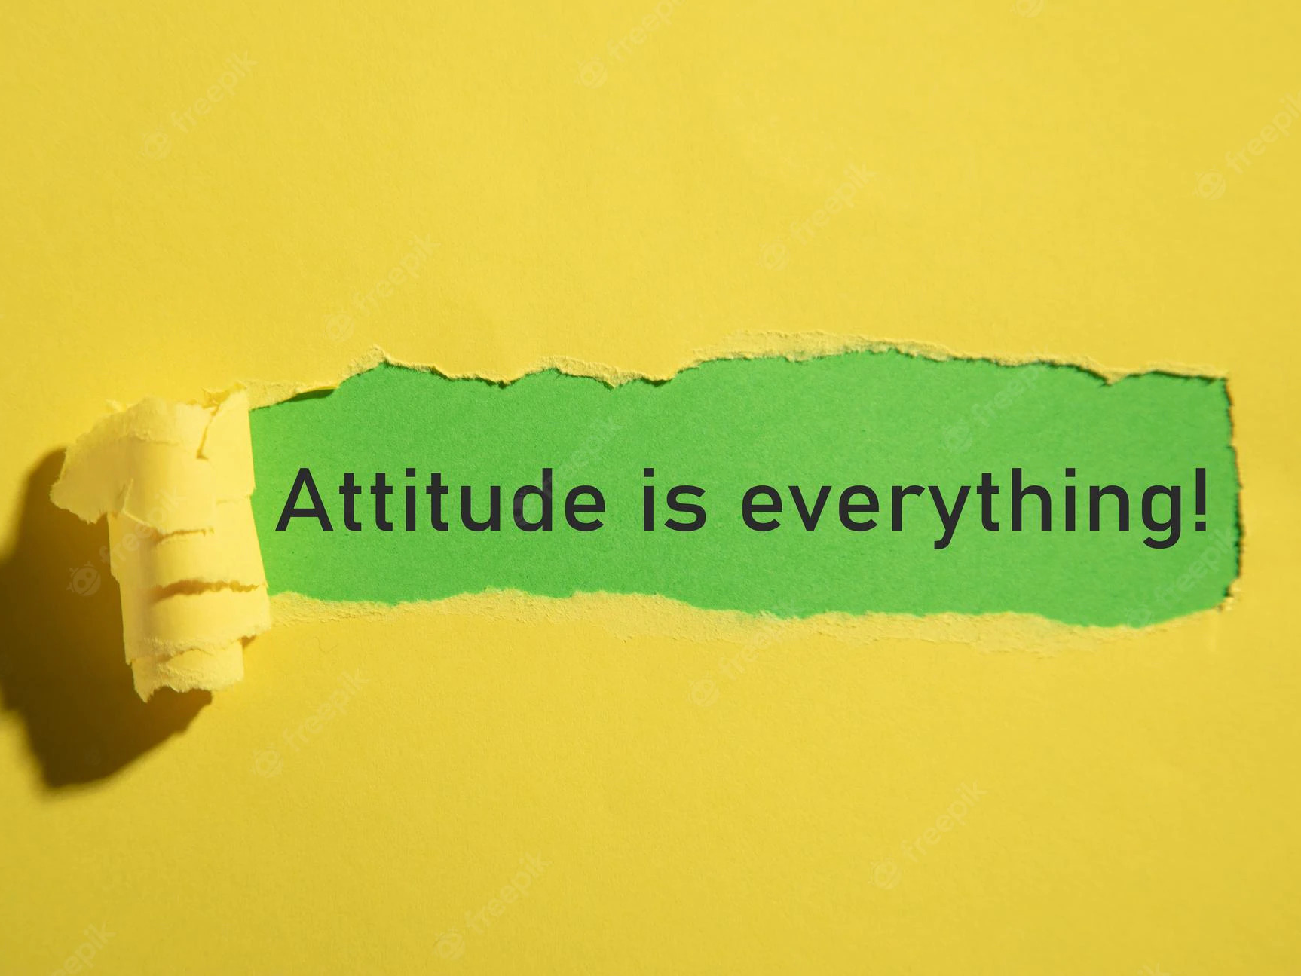

Slide 11
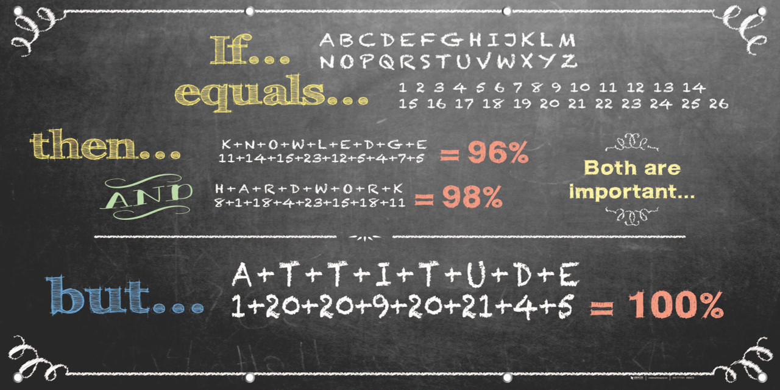

Slide 12
Exams
Mid-term exam date: Apr. 19
Final exam date: Jun. 21

Slide 13


Slide 14
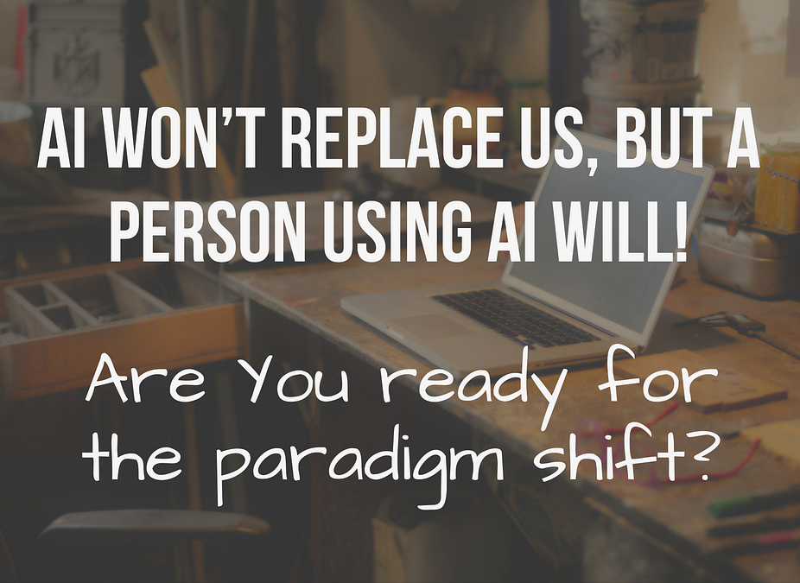

Slide 15
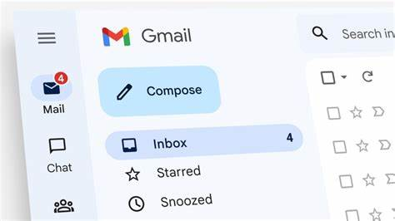
Gmail
Create your gmail account.

Slide 16

Slack
Join the workspace

Slide 17


Slide 18
Toastmasters
Mission Statement
We provide a supportive and positive learning environment in which members are empowered to develop communication and leadership skills, resulting in greater self-confidence and personal growth.
Daegu Toastmasters
Saturday morning
Toastmasters International -Daegu Toastmasters
Y.O.L.O. Toastmasters
Tuesday evening
Toastmasters International -Y.O.L.O Toastmasters
Submit the pictures via e-mail after attending a Toastmasters meeting. You’ll receive an additional point on your grade.

Slide 19
Further Studies
The Missing Semester of Your CS Education
https://missing.csail.mit.edu/
Watch a movie
https://www.imdb.com/title/tt2084970

Slide 20
“I have this hope that there is a better way. Higher-level tools that actually let you see the structure of the software more clearly will be of tremendous value.”
– Guido Van Rossum

